Slide 1

Automated Public Lighting
APL
Theme : Smart Automation

Slide 2

Team Leader: Karthika R
Members :
Anitha R
Harish M
Logeswaran R
Chandravel MK
Somashekar M
Tech Fusion
FABRIKAM RESIDENCES

Slide 3
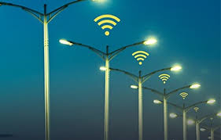
Introduction
Welcome to the Automated Public Lighting Project—a transformative initiative aimed at enhancing our communities through efficient, safe, and sustainable lighting solutions.
This project seeks to harness cutting-edge technology to optimize public lighting, reduce energy consumption, and improve overall quality of life

Slide 4

Project Scope
Our project encompasses the implementation of automated lighting solutions in Streets And Highways.
This initiative involves the installation of state-of-the-art hardware and software systems to intelligently control public lighting, ensuring cost-effective, environmentally friendly, and safe illumination across our community.

Slide 5
Technology and Analystics
Technology Selection
Data Analytics and Monitoring
In selecting technology for the Automated Public Lighting project, we opted for energy-efficient LED lighting and IoT-based control systems.
LEDs offer longevity and reduced energy consumption, while IoT technology enables real-time monitoring and adaptive lighting based on factors like traffic and ambient light conditions, enhancing efficiency and sustainability.
Data Analytics and Monitoring in the automated public lighting project involve collecting data from sensors to track lighting usage, energy consumption, and environmental conditions.
real-time monitoring ensures system performance and allows for adjustments based on data insights.

Slide 6
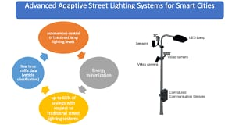
Hardware Installation
Hardware installation for the Automated Public Lighting project involves placing lighting fixtures, sensors, and controllers in designated areas
Proper wiring and data connectivity are established to ensure seamless communication between components.
This phase ensures that the physical infrastructure is in place to support automated lighting control

Slide 7
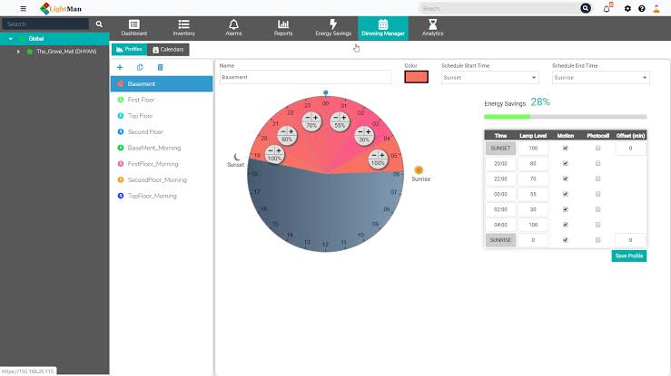
Software Development
In software development for an Automated Public Lighting project, we create algorithms to control lighting based on data from sensors.
Additionally, we design a user-friendly interface for monitoring and managing the system, allowing users to adjust settings and view real-time data.

Slide 8
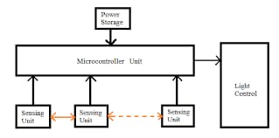
Testing and Optimization
Testing and Optimization involves rigorous evaluation of the automated public lighting system.
It includes hardware and software testing to identify and rectify issues.
Data-driven optimization fine-tunes lighting algorithms for efficiency and effectiveness, ensuring the system aligns with project goals and community needs.

Slide 9
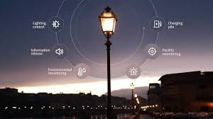
Deployment and Maintenance
Deployment involves the phased rollout of lighting infrastructure, ensuring proper installation and connectivity.
Maintenance encompasses routine inspections, repairs, and software updates to ensure system functionality, longevity, and adherence to energy-saving standards, maintaining efficient, safe, and sustainable public lighting.

Slide 10
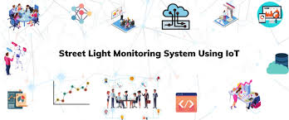
Benefits
1. Energy Efficiency
2. Cost Savings
3. Enhanced Safety
4. Reduced Light Pollution
5. Sustainability

Slide 11
Conclusion
The Automated Public Lighting Project represents a transformative step towards energy-efficient, safe, and sustainable urban environments.
With cutting-edge technology, strategic planning, and community involvement, we aim to illuminate the path to a brighter and greener future for our cities.
Thank You

